Slide 1


MESH
Compacting the Uncompactable!
Automatically Compacting
Your C++ Application’s Memory
Emery Berger UMass Amherst
with Bobby Powers, David Tench, & Andrew McGregor
University of Massachusetts Amherst
http://libmesh.org
[PLDI 2019]
Notes:
All programs can INDUCE memory fragmentation when they run

Slide 4
Reconquer all of Spain!

Slide 5
Reconquer all of Spain!
MALLOC

Slide 6
Reconquer Allocate all of Spain!
MALLOC

Slide 7
MALLOC

Slide 8
MALLOC

Slide 9

(malloc)
MALLOC

Slide 10
MALLOC

Slide 11
MALLOC

Slide 12
MALLOC

Slide 13
MALLOC

Slide 14
MALLOC

Slide 15
MALLOC

Slide 16
MALLOC

Slide 17
MALLOC

Slide 18
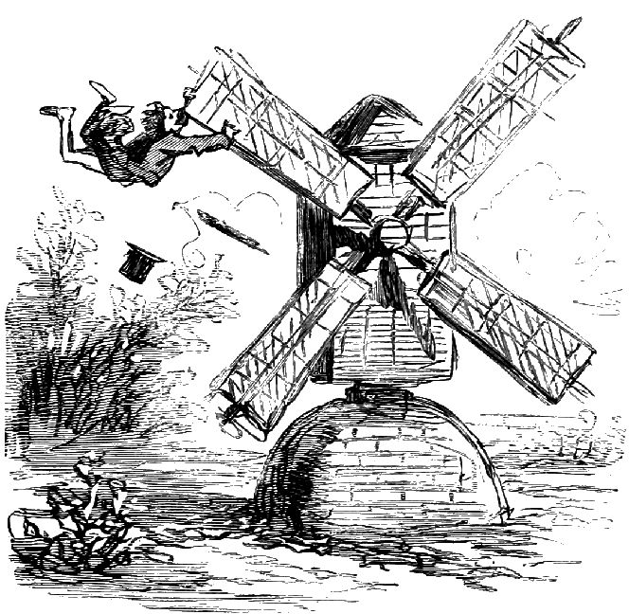
MALLOC

Slide 19
MALLOC

Slide 20
MALLOC

Slide 21
MALLOC
?

Slide 22
MALLOC
?

Slide 23
MALLOC
!

Slide 24
MALLOC
¡
!

Slide 25


¡
!

Slide 26
¡Fragmentación!
OS Page (“Spain”)
Live objects (malloc’d)
Notes:
All programs can INDUCE memory fragmentation when they run, where a program requires dramatically more memory from the Operating System than the sum of the sizes of live objects.

Slide 27
¡Fragmentación!
OS Pages
+
+
Live objects
+
+
Notes:
All programs can suffer from memory fragmentation, where a program requires dramatically more memory from the Operating System than the sum of the sizes of live objects.

Slide 28
¡Fragmentación!
OS Pages
≫ 1
+
+
Live objects
+
+
Notes:
All programs can suffer from memory fragmentation, where a program requires dramatically more memory from the Operating System than the sum of the sizes of live objects.

Slide 29
¡Fragmentación!
OS Pages
O(log )
13x!
+
+
[Robson ’77]
Live objects
+
+
Notes:
All programs can suffer from memory fragmentation, where a program requires dramatically more memory from the Operating System than the sum of the sizes of live objects.

Slide 30
¿Compactación?
OS Pages
O(log )
13x!
+
+
[Robson ’77]
Live objects
+
+
Notes:
All programs can suffer from memory fragmentation, where a program requires dramatically more memory from the Operating System than the sum of the sizes of live objects.

Slide 31
¿Compactación?
OS Pages
O(1)
+
+
Live objects
+
+
Notes:
All programs can suffer from memory fragmentation, where a program requires dramatically more memory from the Operating System than the sum of the sizes of live objects.

Slide 32
¡
!

Slide 38
Notes:
But there is a, lets say, significant body of software out there that isn’t written in garbage collected languages
Our popular dynamic language implementations

Slide 39
Notes:
But there is a, lets say, significant body of software out there that isn’t written in garbage collected languages
Our popular dynamic language implementations

Slide 40
Notes:
But there is a, lets say, significant body of software out there that isn’t written in garbage collected languages
Our popular dynamic language implementations

Slide 41
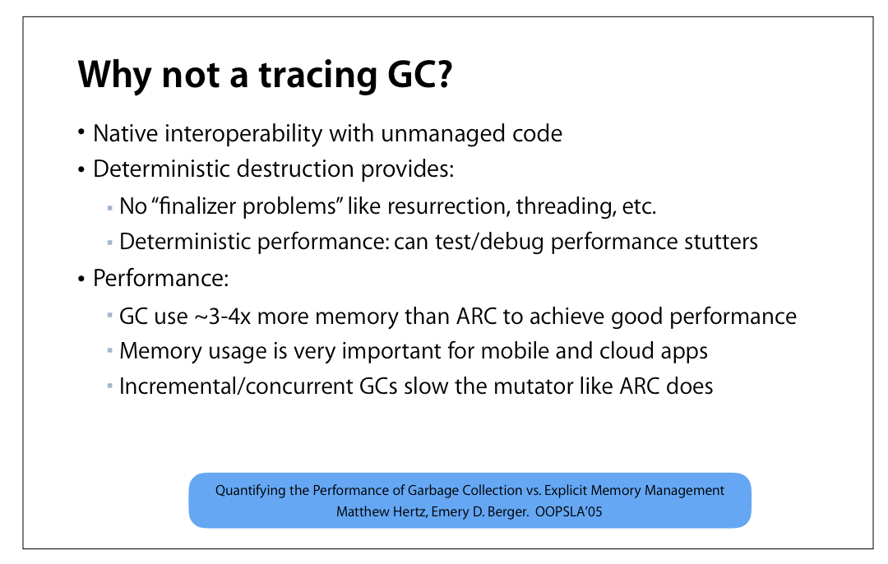
[Lattner, 2016]
Notes:
But there is a, lets say, significant body of software out there that isn’t written in garbage collected languages
Our popular dynamic language implementations

Slide 42
Notes:
But there is a, lets say, significant body of software out there that isn’t written in garbage collected languages
Our popular dynamic language implementations

Slide 43
Notes:
But there is a, lets say, significant body of software out there that isn’t written in garbage collected languages
Our popular dynamic language implementations

Slide 44



Notes:
But there is a, lets say, significant body of software out there that isn’t written in garbage collected languages
Our popular dynamic language implementations

Slide 45

Notes:
But there is a, lets say, significant body of software out there that isn’t written in garbage collected languages
Our popular dynamic language implementations

Slide 46
Notes:
In garbage collected languages, this problem has been solved for decades.

Slide 47
¡Compactación!
Notes:
In garbage collected languages, this problem has been solved for decades.

Slide 48
Compaction In Action
References
OS Page
Live objects
Notes:
move objects together to save space, and soundly update all references

Slide 49
Notes:
move objects together to save space, and soundly update all references

Slide 50
Notes:
move objects together to save space, and soundly update all references

Slide 51
Notes:
move objects together to save space, and soundly update all references

Slide 52
Notes:
move objects together to save space, and soundly update all references

Slide 53
Page returned
to the OS
Notes:
move objects together to save space, and soundly update all references

Slide 54
$ clang++ -o yolo main.cc
$ strip yolo
$ LD_PRELOAD=libmesh.so ./yolo
Notes:
Programs in these languages are compiled down to machine code

Slide 55
$ clang++ -o yolo main.cc
$ strip yolo
$ LD_PRELOAD=libmesh.so ./yolo
Notes:
Often stripped not just of debug symbols but all symbols

Slide 56
$ clang++ -o yolo main.cc
$ strip yolo
$ ./yolo
No way to precisely distinguish pointers from integers
Notes:
Which means when we run this program, we don’t have a way to distinguish pointers from integers in memory

Slide 57
$ clang++ -o yolo main.cc
$ strip yolo
$ ./yolo
0xDEADC000
No way to precisely distinguish pointers from integers
Notes:
Which means when we run this program, we don’t have a way to distinguish pointers from integers in memory

Slide 58
$ clang++ -o yolo main.cc
$ strip yolo
$ ./yolo
0xDEADC000
No way to precisely distinguish pointers from integers
0xBEEFC000
Notes:
Which means when we run this program, we don’t have a way to distinguish pointers from integers in memory

Slide 59
0xDEADC000
$ clang++ -o yolo main.cc
$ strip yolo
$ ./yolo
0xDEADC000
No way to precisely distinguish pointers from integers
0xBEEFC000
Notes:
Which means when we run this program, we don’t have a way to distinguish pointers from integers in memory

Slide 60
0xDEADC000
$ clang++ -o yolo main.cc
$ strip yolo
$ ./yolo
?
0xDEADC000
No way to precisely distinguish pointers from integers
0xBEEFC000
Notes:
Which means when we run this program, we don’t have a way to distinguish pointers from integers in memory

Slide 61
$ cc -o yolo main.cc
$ strip yolo
$ ./yolo
(this is why the Boehm GC for C/C++ is conservative and non-moving)
Notes:
and often run without debug info or even symbols present

Slide 62
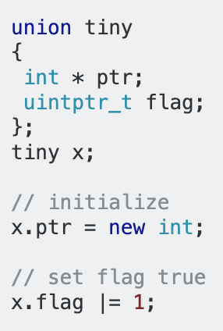
Notes:
Even if you had type information, there are a number of ways for developers to obscure the memory in-memory representation of references, like using the low bits of pointers as bit flags

Slide 63
0xDEADC001
?
0xDEADC000
0xBEEFC000
Notes:
Even if you had type information, there are a number of ways for developers to obscure the memory in-memory representation of references, like using the low bits of pointers as bit flags

Slide 64
0xDEADC001
?
0xDEADC000
0xBEEFC000
Notes:
Even if you had type information, there are a number of ways for developers to obscure the memory in-memory representation of references, like using the low bits of pointers as bit flags

Slide 65
Robson bounds: non-moving allocators are subject to catastrophic fragmentation
Notes:
On top of these practical issues, the Robson bounds show that non-moving allocators are subject to intense fragmentation, related logarithmically to the ratio of the largest size class to the smallest.

Slide 66
MESH
Compaction without
Relocation for C/C++
No code changes
No recompilation
LD_PRELOAD and go

Slide 67
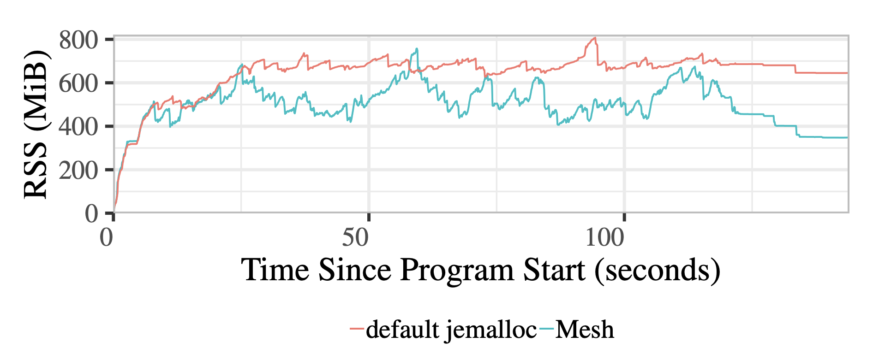
17% heap size reduction
< 1% performance overhead
Notes:
Mesh is able to decrease the memory usage of an application like Firefox by 17% on a well known web benchmark with under a 1% impact on performance.

Slide 68



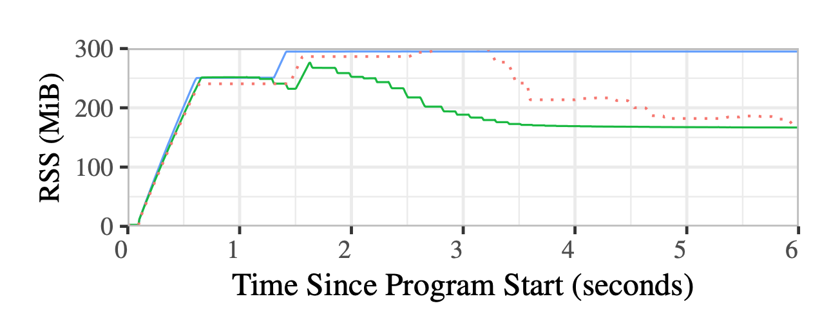
no compaction
Notes:
Mesh's general approach is able to do just as well as application-specific techniques. The redis key/value datastore built their own compaction technique to recover from fragmentation, but its overhead is high enough that it is disabled by default. Mesh is able to reclaim the same amount of space as this bespoke solution

Slide 69
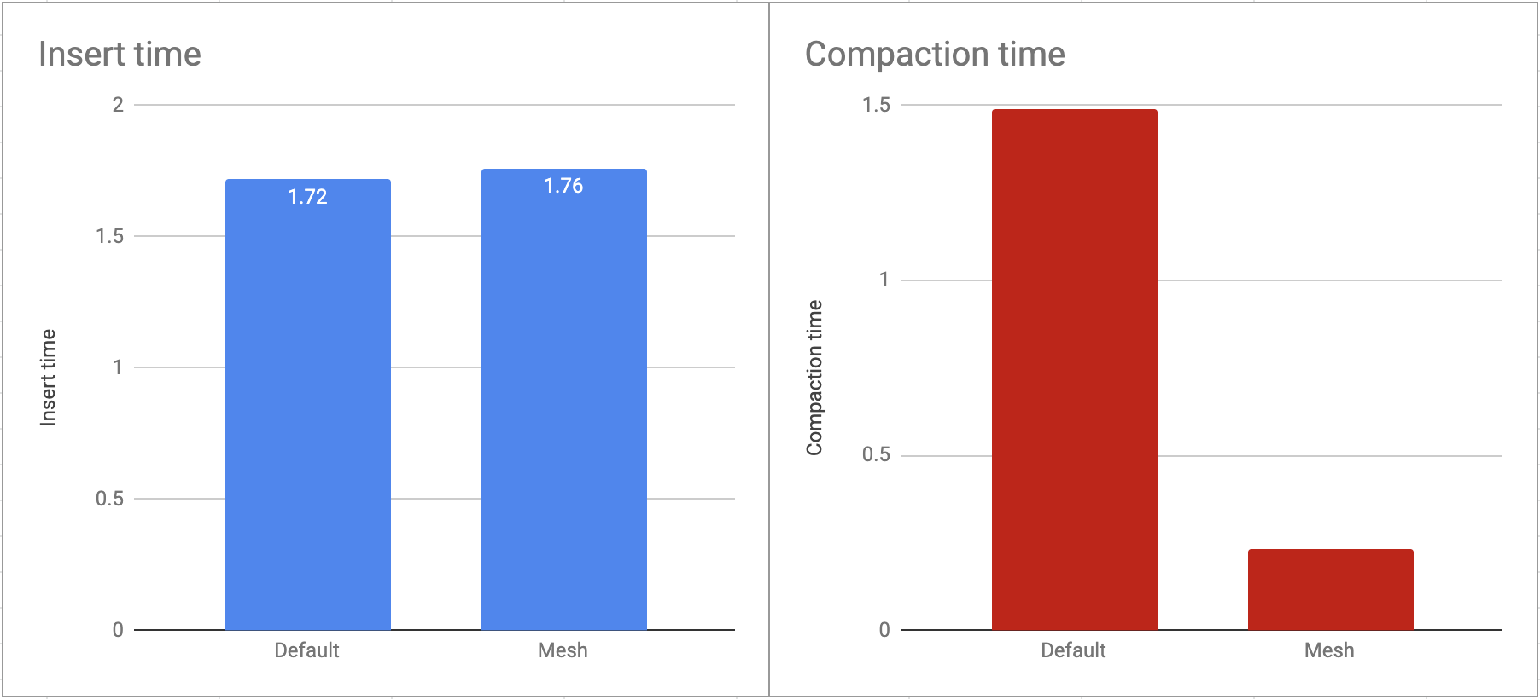
5x reduction in
time spent
compacting
Notes:
but with reclaimation being 5x faster

Slide 70
MESH
Compaction without
Relocation for C/C++
Mechanism
Randomized allocation
Finding pages to compact

Slide 71
Meshing: compaction without (virtual!) relocation
Notes:
Well, we know how to do this when programming languages place certain restrictions on the developer.

Slide 72
Pages are Meshable when they:
Hold objects of the same size class

Slide 73
0
1
2
5
4
7
10
9
11
14
12
15
Pages are Meshable when they:
Hold objects of the same size class
Have non-overlapping object offsets

Slide 74
Meshing
Virtual
Physical

Slide 75
Meshing
Mark virtual
page read-only
Virtual
Physical

Slide 76
Meshing
Virtual
Physical
Copy
(maintaining
offsets)

Slide 77
Meshing
Virtual
Physical
Update
page tables
with mmap,
memfd,
MAP_SHARED

Slide 78
Meshing
Mark virtual
page read/write
Virtual
Physical

Slide 79
Meshing
Virtual
Physical
Physical page
returned to OS

Slide 80
Meshing
No virtual
addresses
changed!
Virtual
Physical

Slide 81
Randomized Allocation

Slide 82
Worst Case:

Slide 83
Worst Case:
low occupancy, non-meshable pages

Slide 84
Worst Case:
many
low occupancy, non-meshable pages

Slide 85
Standard
allocators

Slide 86
malloc(256)
Standard
allocators

Slide 87
malloc(256)
Standard
allocators

Slide 88
malloc(256)
Standard
allocators

Slide 89
Mesh uses randomization to ensure live objects are uniformly distributed

Slide 90
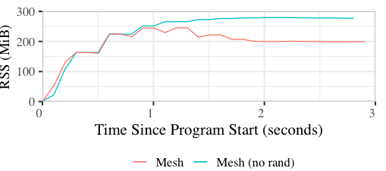
Regular allocation patterns are real
Notes:
This isn’t hypothetical - it is trivial to write functional code in languages like Ruby that exhibits regular allocation patterns we can’t recover from

Slide 91
How to randomize allocation?

Slide 92
Random probing:
while true:
if rand_off().is_free:
return rand_off

Slide 93
malloc(256)
Random probing:
while true:
if rand_off().is_free:
return rand_off

Slide 94
malloc(256)
Random probing:
while true:
if rand_off().is_free:
return rand_off

Slide 95
malloc(256)
Random probing:
while true:
if rand_off().is_free:
return rand_off

Slide 96
malloc(256)
Random probing:
while true:
if rand_off().is_free:
return rand_off
(DieHard [Berger & Zorn 2006])

Slide 97
Random probing fast in expectation iff page occupancy is low

Slide 98
Random probing fast in expectation iff page occupancy is low
but this is at odds with minimizing heap size!

Slide 99
Shuffle Vector:
Fast randomized
allocation + full page utilization

Slide 100
Shuffle Vector: Fast randomized allocation
Page
0
1
2
3
load
Thread-local shuffle vector

Slide 101
Shuffle Vector: Fast randomized allocation
Page
load
0
1
2
3
Thread-local shuffle vector

Slide 102
Shuffle Vector: Fast randomized allocation
Page
shuffle( )
0
1
2
3
Thread-local shuffle vector

Slide 103
Shuffle Vector: Fast randomized allocation
Page
shuffle( )
2
3
1
0
Thread-local shuffle vector

Slide 104
Shuffle Vector: Fast randomized allocation
Page
malloc()
2
3
1
0
Thread-local shuffle vector

Slide 105
Shuffle Vector: Fast randomized allocation
Page
malloc()
page_start +
* object_size
3
1
0
2
Thread-local shuffle vector

Slide 106
Shuffle Vector: Fast randomized allocation
Page
free( )
2
3
1
0
Thread-local shuffle vector

Slide 107
Shuffle Vector: Fast randomized allocation
Page
free( )
2
3
1
0
Thread-local shuffle vector

Slide 108
Shuffle Vector: Fast randomized allocation
Page
free( )
shuffle_one( )
2
3
1
0
Thread-local shuffle vector

Slide 109
Shuffle Vector: Fast randomized allocation
Page
free( )
shuffle_one( )
1
3
2
0
Thread-local shuffle vector

Slide 110
Shuffle Vector: Fast randomized allocation
Page
free( )
1
3
2
0
Thread-local shuffle vector

Slide 111
All
Pages
Meshable

Slide 112
Finding pages to Mesh

Slide 113
Problem: Find meshing that releases maximum number of pages

Slide 114
Problem: Find meshing that releases maximum number of pages
Run in the free() slowpath
At most once every 100 ms
Treat each size class independently

Slide 115
Problem: Find meshing that releases the maximum number of pages
Page
Pages can
be meshed

Slide 116
MinCliqueCover

Slide 117
MinCliqueCover
(NP-Complete)

Slide 118
MinCliqueCover
(NP-Complete)
BUT! Randomness ensures we can get away with solving simpler graph problem (Matching)

Slide 119
Wrinkle: building this graph would require RAM + time

Slide 120
SplitMesher: approximates Matching without materializing meshing graph

Slide 121
SplitMesher: approximates Matching without materializing meshing graph
Set of partially full pages
Pairs of meshable pages

Slide 123
Iterate, comparing a[i] to b[i]

Slide 124
Iterate, comparing a[i] to b[i]

Slide 125
Iterate, comparing a[i] to b[i]

Slide 126
Iterate, comparing a[i] to b[i]

Slide 127
loop, comparing a[i] to b[(i+1)%len]

Slide 128
loop fixed number of times, comparing a[i] to b[(i+1)%len]

Slide 130
Remove found match

Slide 131
Continue

Slide 132
SplitMesher: approximates Matching without materializing meshing graph

Slide 133
SplitMesher: approximates Matching without materializing meshing graph
O(n/q) time
(q is the global probability of spans meshing)

Slide 134
SplitMesher: approximates Matching without materializing meshing graph
O(n/q) time
(q is the global probability of spans meshing)
1/2* approximation w.h.p.

Slide 135
MESH
implementation details

Slide 136
MESH
implementation details
built using Heap Layers
github.com/emeryberger/Heap-Layers

Slide 137
MESH
implementation details
built using Heap Layers
github.com/emeryberger/Heap-Layers
(used to build Hoard, DieHard, DieHarder…)

Slide 138
MESH
implementation details
built using Heap Layers
github.com/emeryberger/Heap-Layers
(used to build Hoard, DieHard, DieHarder…)
fast framework for building custom allocators!

Slide 139
MESH
implementation details
built using Heap Layers
github.com/emeryberger/Heap-Layers
(used to build Hoard, DieHard, DieHarder…)
< 5K SLOC, C++

Slide 140
MESH
implementation details
built using Heap Layers
github.com/emeryberger/Heap-Layers
(used to build Hoard, DieHard, DieHarder…)
< 5K SLOC, C++

Slide 141
MESH
implementation details
built using Heap Layers
github.com/emeryberger/Heap-Layers
(used to build Hoard, DieHard, DieHarder…)
< 5K SLOC, C++

Slide 142
MESH
implementation details
built using Heap Layers
github.com/emeryberger/Heap-Layers
(used to build Hoard, DieHard, DieHarder…)
< 5K SLOC, C++

Slide 143
MESH
implementation details
built using Heap Layers
github.com/emeryberger/Heap-Layers
(used to build Hoard, DieHard, DieHarder…)
< 5K SLOC, C++

Slide 144
MESH
implementation details
built using Heap Layers
github.com/emeryberger/Heap-Layers
(used to build Hoard, DieHard, DieHarder…)
< 5K SLOC, C++

Slide 145
no compaction
Notes:
Well, we know how to do this when programming languages place certain restrictions on the developer.

Slide 146
+ MESH
Notes:
Well, we know how to do this when programming languages place certain restrictions on the developer.

Slide 147
17% heap size reduction
< 1% performance overhead
Notes:
Mesh is able to decrease the memory usage of an application like Firefox by 17% on a well known web benchmark with under a 1% impact on performance.

Slide 148
Ruby Compaction for Free
Notes:
This isn’t hypothetical - it is trivial to write functional code in languages like Ruby that exhibits regular allocation patterns we can’t recover from

Slide 149
LIBMESH
http://
.org
¡Compactación sin Relocación!
(compaction without relocation)
Browsix, Coz, DieHard, Hoard…

Slide 150
Notes:
This slide left intentionally blank.

Slide 151
Latency: malloc

Slide 152
Latency: free

